Slide 1

Chitin Predators

Slide 2
Description
Survival game where you play as one of three predator classes: trapper (spider), hunter (scorpion), and scout (centipede). Each class is at an advantage against one of the two other classes, and suffers a disadvantage against the other.
Multiple players will occupy the same worldspace as predators and compete over the limited resources, instigating PVP interactions.
The goal of the game is to survive as long as possible, which entails remaining sated, hydrated, and... not falling to another predator’s attacks.

Slide 3
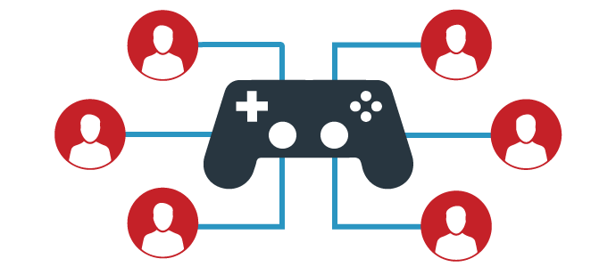
Players
Matches require at least two players
Matches allow up to seven additional players in the same gameworld
Players can choose from three classes, which each have unique roles and abilities, allowing for both a different styles of play depending on the selected class, and counter based competitive play:
Player Interaction Patterns:
multilateral competition , player vs. player

Slide 4
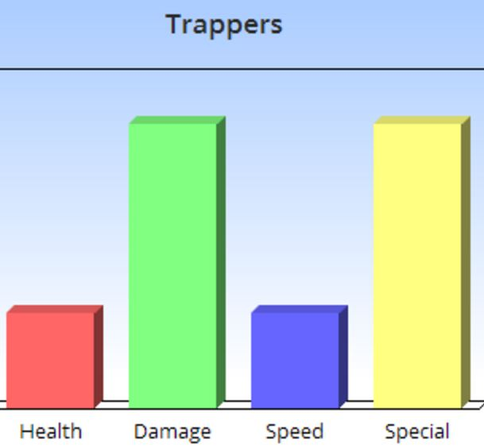
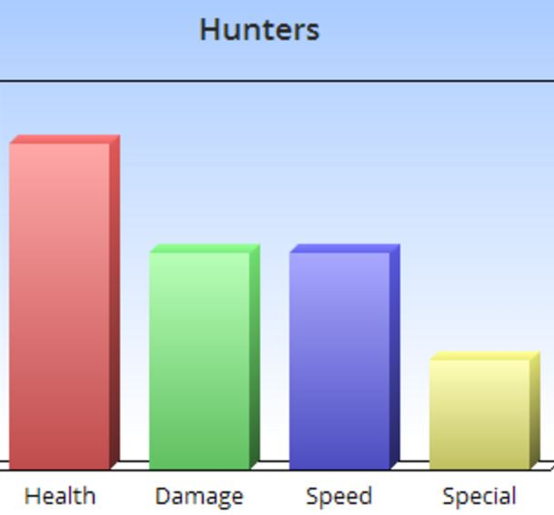
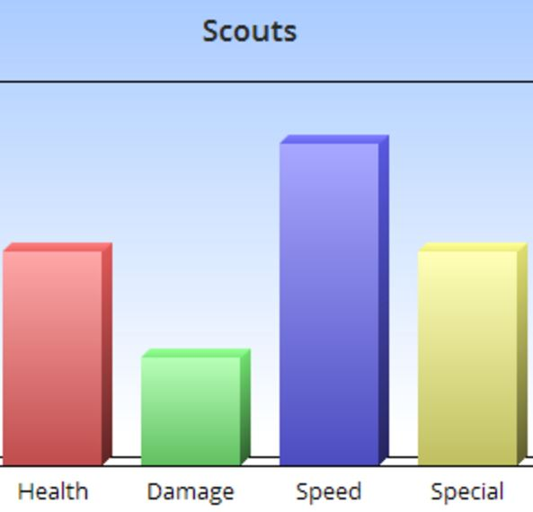
Creature Classes
Trapper >> {slows,disables} >> Hunter >> {overpowers} >> Scout >> {avoids,outspeeds} >> Trapper
Notes:
Adding stamina later

Slide 5
Objectives
Capture: destroy prey to consume their energy, also known as hunting
Chase/Escape: elude other predators, especially those of a disadvantageous class, OR chase after your prey and other predators!
Race: reach prey, and other resources, before other players
Exploration: explore the gameworld to discover prey, water locations, and hiding spots
Outwit: use the knowledge gained from exploration, especially that of the terrain, against other players
In other words… Survive i.e. gather necessary resources first, avoid death by predator second

Slide 6

Procedures
Game begins when there’s at least two players logged in; game stops accepting connection after 3 mins
All players can perform default attack (LMB); damage is determined with respect to involved classes
Player (Trapper) can shoot web strings (RMB) [10 sec cd]: targets receive damage vs health {min} and are slowed {min} spin web traps (R) [60 sec cd]: creatures that activates trap are stunned {min} and then slowed {med} Player (Hunter) and (Scout) can...
Players can move (W,A,S,D), jump (spacebar), slide along the ground / dash (Q,E), eat and drink (Z)
Players may disconnect (ESC) at any time; this ends the game if there are no more players
If there is only one player left, then that player wins the game

Slide 7
Rules
Predators can only see a short distance in all unobscured directions (~have other senses besides sight)
Players that are reduced to either a food or water resource of [ 0 ] start taking residual damage vs health
Health can only be recovered by consuming predators (encourages players look for advantageous PvP)
Players that run out of health, or fall on certain environmental hazards (deep water), suffer death
Players that suffer death, are then removed from play for the rest of the game

Slide 8




Resources
Water
Food (other small bugs who are NPCs that you must hunt down)
LIMITED dynamically to accommodate player count; non-renewable
Timer (hunger/thirst have a player-specific timer; eat/drink to increase timer)
Shelter (away from weather, disguised from prey and hidden from predators)
Class-specific abilities (cd timer)

Slide 9
Conflicts
Players will need to…
ensure that they maintain resources (food,water) vs resource timer
avoid damage and death via predators and environmental hazards
hunt down and consume prey before another player does
avoid or elude other players, who may try and kill them
hunt down other players, especially when food depletes

Slide 10
Boundaries
Gameworld held within a forest-like area (tall grass, etc) on an island
Borders will surround the island on all sides:
The borders will be deep water; insta-death (environmental hazard)
As time goes on, the water borders will start rising, forcing players to start heading towards the middle. This ensures that rounds do not last too long.

Slide 11
Outcome
The last player alive wins the game, all other players lose
The game can start again, and players can try out new predators

Slide 12
Free Images Provided by:
https://www.pubnub.com/wp-content/uploads/2011/11/MutliplayerGames1.png
http://game-icons.net/icons/carl-olsen/originals/svg/spider-face.svg
https://cdn2.iconfinder.com/data/icons/law-and-crime-2/512/drawing4-512.png
https://cdn2.iconfinder.com/data/icons/large-svg-icons/512/bug_insect_ladybird_animal-512.png
https://cdn4.iconfinder.com/data/icons/water-supply/512/water_supply_10-512.png
http://wfarm3.dataknet.com/static/resources/icons/set114/dc813e1.png
http://louisianademocratslafourche.webstarts.com/ldl/images/iconplus.png

Slide 13
